Slide 1
Data Link Layer

Slide 2
Wireless Links
Wireless links transmit electromagnetic signals
Radio, microwave, infrared
Wireless links all share the same “wire” (so to speak)
The challenge is to share it efficiently without unduly interfering with each other
Most of this sharing is accomplished by dividing the “wire” along the dimensions of frequency and space
Exclusive use of a particular frequency in a particular geographic area may be allocated to an individual entity such as a corporation

Slide 3
Wireless Links
These allocations are determined by government agencies such as FCC (Federal Communications Commission) in USA
Specific bands (frequency) ranges are allocated to certain uses.
Some bands are reserved for government use
Other bands are reserved for uses such as AM radio, FM radio, televisions, satellite communications, and cell phones
Specific frequencies within these bands are then allocated to individual organizations for use within certain geographical areas.
Finally, there are several frequency bands set aside for “license exempt” usage
Bands in which a license is not needed

Slide 4
Wireless Links
Devices that use license-exempt frequencies are still subject to certain restrictions
The first is a limit on transmission power
This limits the range of signal, making it less likely to interfere with another signal
For example, a cordless phone might have a range of about 100 feet.
The second restriction requires the use of Spread Spectrum technique
Idea is to spread the signal over a wider frequency band
So as to minimize the impact of interference from other devices
Originally designed for military use

Slide 5
Wireless Links
Frequency hopping
Transmitting signal over a random sequence of frequencies
First transmitting at one frequency, then a second, then a third…
The sequence of frequencies is not truly random, instead computed algorithmically by a pseudorandom number generator
The receiver uses the same algorithm as the sender, initializes it with the same seed, and is
Able to hop frequencies in sync with the transmitter to correctly receive the frame

Slide 6
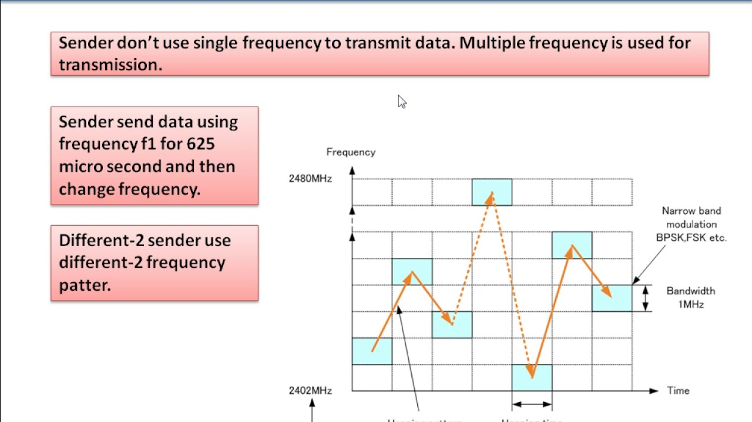
Wireless Links

Slide 7
Wireless Links
A second spread spectrum technique called Direct sequence
Represents each bit in the frame by multiple bits in the transmitted signal.
For each bit the sender wants to transmit
It actually sends the exclusive OR of that bit and n random bits
The sequence of random bits is generated by a pseudorandom number generator known to both the sender and the receiver.
The transmitted values, known as an n-bit chipping code, spread the signal across a frequency band that is n times wider

Slide 8
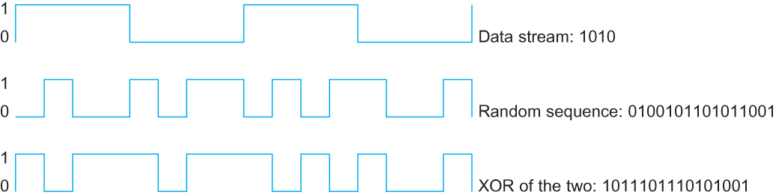
Wireless Links
Example 4-bit chipping sequence

Slide 9
Wireless Links
Wireless technologies differ in a variety of dimensions
How much bandwidth they provide
How far apart the communication nodes can be
Four prominent wireless technologies
Bluetooth
Wi-Fi (more formally known as 802.11)
WiMAX (802.16)
3G cellular wireless

Slide 10
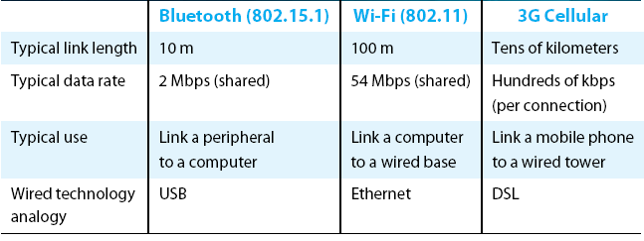
Wireless Links
Overview of leading wireless technologies

Slide 11
Wireless Links
Mostly widely used wireless links today are usually asymmetric
Two end-points are usually different kinds of nodes
One end-point usually has no mobility, but has wired connection to the Internet (known as base station)
The node at the other end of the link is often mobile

Slide 12
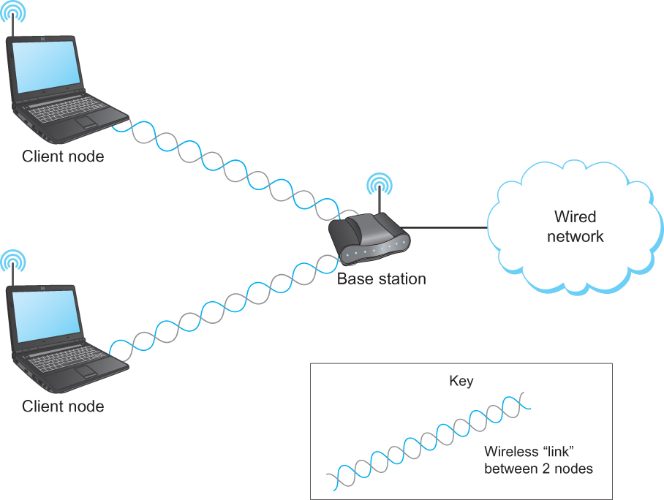
Wireless Links
A wireless network using a base station

Slide 13
Wireless Links
Wireless communication supports point-to-multipoint communication
Communication between non-base (client) nodes is routed via the base station
Three levels of mobility for clients
No mobility: the receiver must be in a fix location to receive a directional transmission from the base station (initial version of WiMAX)
Mobility is within the range of a base (Bluetooth)
Mobility between bases (Cell phones and Wi-Fi)

Slide 14
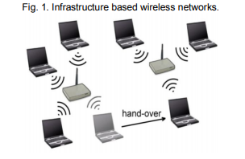
Infrastructure Based Wireless Networks
Nodes are connected with the fixed physical representation. Thus, the nodes are communicated through AP.
Examples : GSM, UMTS and WLAN

Slide 15
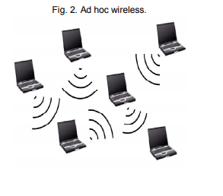
Infrastructureless Wireless Networks
The node is communicated without any fixed physical representation.
The ad hoc networks are formed by connecting the terminals in the multi-hop distributed architecture.
Example: conference applications, intelligent devices or sensor.

Slide 16
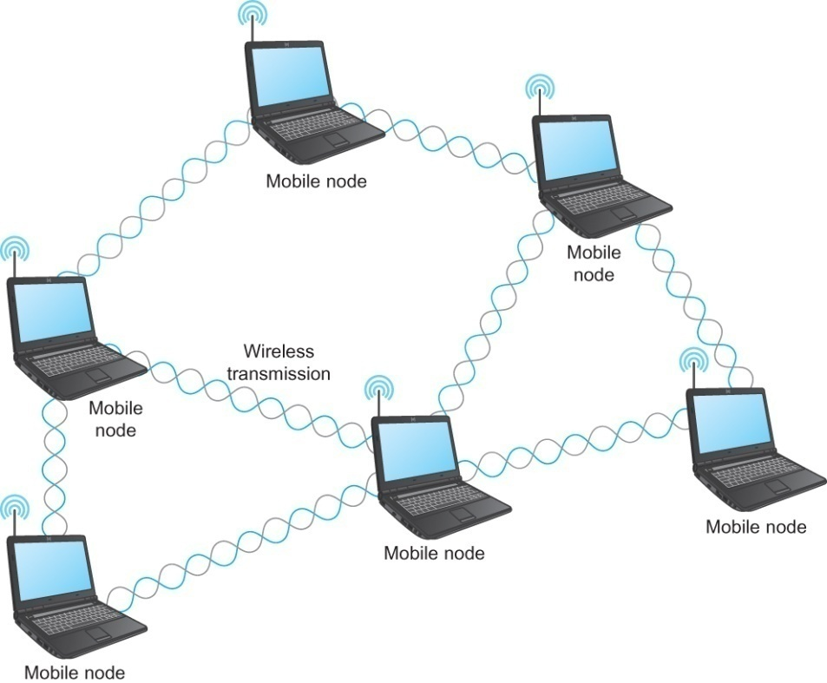
Wireless Links
Mesh or Ad-hoc network
Nodes are peers
Messages may be forwarded via a chain of peer nodes
A wireless ad-hoc or mesh network

Slide 17
IEEE 802.11
Also known as Wi-Fi
Like its Ethernet and token ring siblings, 802.11 is designed for use in a limited geographical area (homes, office buildings, campuses)
Primary challenge is to mediate access to a shared communication medium – in this case, signals propagating through space
802.11 supports additional features
power management and
security mechanisms

Slide 18
IEEE 802.11
Original 802.11 standard defined two radio-based physical layer standard
One using the frequency hopping
Over 79 1-MHz-wide frequency bandwidths
Second using direct sequence
Using 11-bit chipping sequence
Both standards run in the 2.4-GHz and provide up to 2 Mbps
Then physical layer standard 802.11b was added
Using a variant of direct sequence 802.11b provides up to 11 Mbps
Uses license-exempt 2.4-GHz band
Then came 802.11a which delivers up to 54 Mbps using OFDM
802.11a runs on license-exempt 5-GHz band
Most recent standard is 802.11g which is backward compatible with 802.11b
Uses 2.4 GHz band, OFDM and delivers up to 54 Mbps

Slide 19
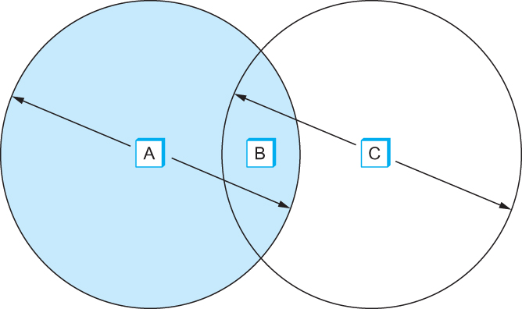
IEEE 802.11 – Collision Avoidance
Consider the situation in the following figure where each of four nodes is able to send and receive signals that reach just the nodes to its immediate left and right
For example, B can exchange frames with A and C, but it cannot reach D
C can reach B and D but not A
Example of a wireless network

Slide 20
IEEE 802.11 – Collision Avoidance
Suppose both A and C want to communicate with B and so they each send it a frame.
A and C are unaware of each other since their signals do not carry that far
These two frames collide with each other at B
But unlike an Ethernet, neither A nor C is aware of this collision
A and C are said to hidden nodes with respect to each other

Slide 21
IEEE 802.11 – Collision Avoidance
The “Hidden Node” Problem. Although A and C are hidden from each
other, their signals can collide at B. (B’s reach is not shown.)

Slide 22
IEEE 802.11 – Collision Avoidance
Another problem called exposed node problem occurs
Suppose B is sending to A. Node C is aware of this communication because it hears B’s transmission.
It would be a mistake for C to conclude that it cannot transmit to anyone just because it can hear B’s transmission.
Suppose C wants to transmit to node D.
This is not a problem since C’s transmission to D will not interfere with A’s ability to receive from B.

Slide 23
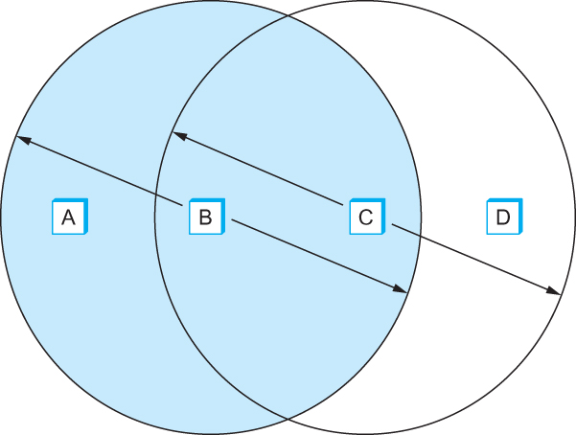
IEEE 802.11 – Collision Avoidance
Exposed Node Problem. Although B and C are exposed to each other’s
signals, there is no interference if B transmits to A while C transmits to D. (A and D’s
reaches are not shown.)

Slide 24
IEEE 802.11 – Collision Avoidance
802.11 addresses these two problems with an algorithm called Multiple Access with Collision Avoidance (MACA).
Key Idea
Sender and receiver exchange control frames with each other before the sender actually transmits any data.
This exchange informs all nearby nodes that a transmission is about to begin
Sender transmits a Request to Send (RTS) frame to the receiver.
The RTS frame includes a field that indicates how long the sender wants to hold the medium
- Length of the data frame to be transmitted
Receiver replies with a Clear to Send (CTS) frame
This frame echoes this length field back to the sender

Slide 25
IEEE 802.11 – Collision Avoidance
Any node that sees the CTS frame knows that
it is close to the receiver, therefore cannot transmit for the period of time it takes to send a frame of the specified length
Any node that sees the RTS frame but not the CTS frame
is not close enough to the receiver to interfere with it, and
so is free to transmit

Slide 26
IEEE 802.11 – Collision Avoidance
Using ACK in MACA
Proposed in MACAW: MACA for Wireless LANs
Receiver sends an ACK to the sender after successfully receiving a frame
All nodes must wait for this ACK before trying to transmit
If two or more nodes detect an idle link and try to transmit an RTS frame at the same time
Their RTS frame will collide with each other
802.11 does not support collision detection
So the senders realize the collision has happened when they do not receive the CTS frame after a period of time
In this case, they each wait a random amount of time before trying again.
The amount of time a given node delays is defined by the same exponential backoff algorithm used on the Ethernet.

Slide 27
IEEE 802.11 – Distribution System
802.11 is suitable for an ad-hoc configuration of nodes that may or may not be able to communicate with all other nodes.
Nodes are free to move around
The set of directly reachable nodes may change over time
To deal with this mobility and partial connectivity,
802.11 defines additional structures on a set of nodes
Instead of all nodes being created equal,
some nodes are allowed to roam
some are connected to a wired network infrastructure
- they are called Access Points (AP) and they are connected to each other by a so-called distribution system

Slide 28
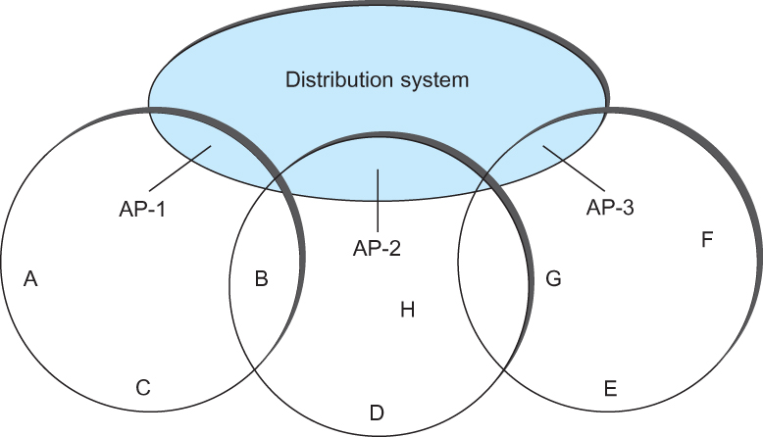
IEEE 802.11 – Distribution System
Following figure illustrates a distribution system that connects three access points, each of which services the nodes in the same region
Each of these regions is analogous to a cell in a cellular phone system with the APIs playing the same role as a base station
The distribution network runs at layer 2 of the ISO architecture
Access points connected to a distribution network

Slide 29
IEEE 802.11 – Distribution System
Although two nodes can communicate directly with each other if they are within reach of each other, the idea behind this configuration is
Each nodes associates itself with one access point
For node A to communicate with node E, A first sends a frame to its AP-1 which forwards the frame across the distribution system to AP-3, which finally transmits the frame to E
Access points connected to a distribution network

Slide 30
IEEE 802.11 – Distribution System
How do the nodes select their access points
How does it work when nodes move from one cell to another
The technique for selecting an AP is called scanning
The node sends a Probe frame
All APs within reach reply with a Probe Response frame
The node selects one of the access points and sends that AP an Association Request frame
The AP replies with an Association Response frame
A node engages this protocol whenever
it joins the network, as well as
when it becomes unhappy with its current AP
This might happen, for example, because the signal from its current AP has weakened due to the node moving away from it
Whenever a node acquires a new AP, the new AP notifies the old AP of the change via the distribution system

Slide 31
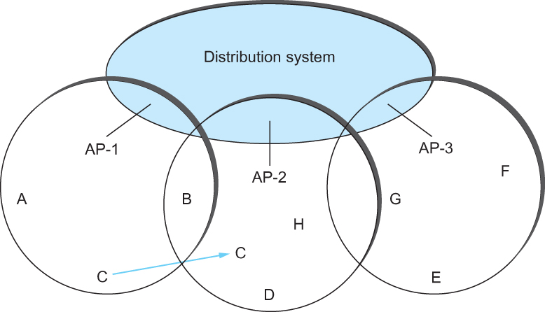
IEEE 802.11 – Distribution System
Consider the situation shown in the following figure when node C moves from the cell serviced by AP-1 to the cell serviced by AP-2.
As it moves, it sends Probe frames, which eventually result in Probe Responses from AP-2.
At some point, C prefers AP-2 over AP-1 , and so it associates itself with that access point.
This is called active scanning since the node is actively searching for an access point
Node Mobility

Slide 32
IEEE 802.11 – Distribution System
APs also periodically send a Beacon frame that advertises the capabilities of the access point; these include the transmission rate supported by the AP
This is called passive scanning
A node can change to this AP based on the Beacon frame simply by sending it an Association Request frame back to the access point.
Node Mobility

Slide 33
IEEE 802.11 – Frame Format
Source and Destinations addresses: each 48 bits
Data: up to 2312 bytes
CRC: 32 bit
Control field: 16 bits
Contains three subfields (of interest)
6 bit Type field: indicates whether the frame is an RTS or CTS frame or being used by the scanning algorithm
A pair of 1 bit fields : called ToDS and FromDS
Frame Format

Slide 34
IEEE 802.11 – Frame Format
How these addresses are interpreted ?
depends on the settings of the ToDS and FromDS bits in the frame’s Control field.
When one node is sending directly to another, both the DS bits are 0,
Addr1 identifies the target node, and Addr2 identifies the source node.
In the most complex case, both DS bits are set to 1,
indicating that the message went from a wireless node onto the distribution
system, and then from the distribution system to another wireless node.
Addr1 identifies the ultimate destination,
Addr2 identifies the immediate sender (the one that forwarded the frame from the distribution system to the ultimate destination),
Addr3 identifies the intermediate destination (the one that accepted the
frame from a wireless node and forwarded it across the distribution system)
Addr4 identifies the original source.
example ( Addr1 corresponds to E, Addr2 identifies AP-3, Addr3 corresponds to AP-1, and Addr4 identifies A)

Slide 35
IEEE 802.11 – Distribution System
Although two nodes can communicate directly with each other if they are within reach of each other, the idea behind this configuration is
Each nodes associates itself with one access point
For node A to communicate with node E, A first sends a frame to its AP-1 which forwards the frame across the distribution system to AP-3, which finally transmits the frame to E
Access points connected to a distribution network

Slide 36
Link utilization vs Link efficiency
link efficiency applies only to a single data transfer over a link
link utilization applies to the total traffic over a link which may well include a number of data transfers multiplexed together.
Link utilization is a more commonly used term in network design.
Link efficiency will depend on the type of ARQ used.

